Slide 1
Ubuntu Server
An overview to using ubuntu server
...as your desktop platform!
Waikato Linux Users Group
Ian Stewart
26 November 2018

Slide 2
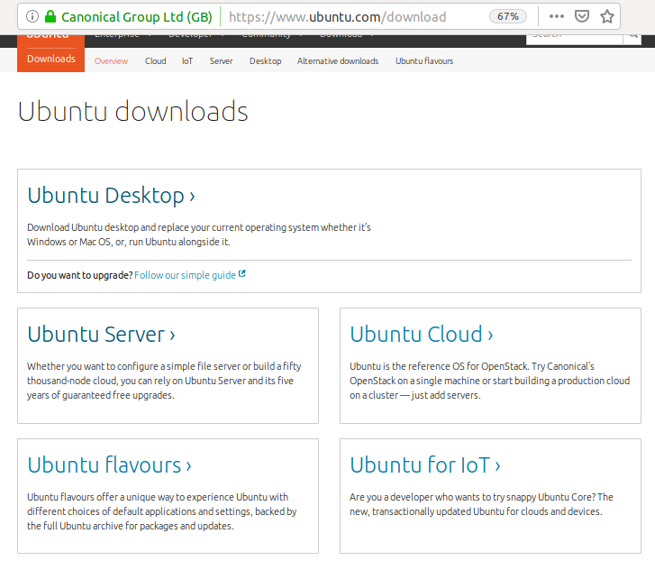
Download
https://www.ubuntu.com/download

Slide 3
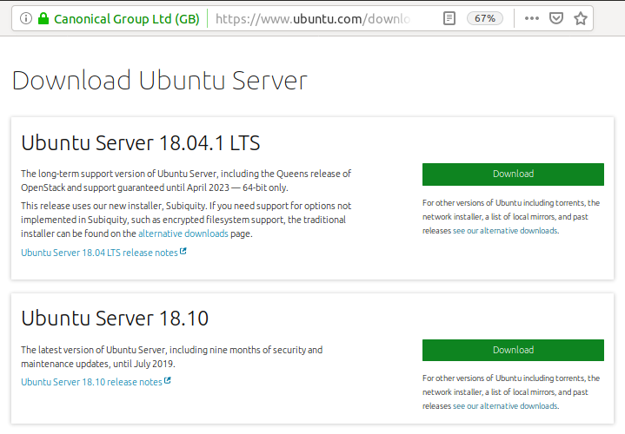
Download
https://www.ubuntu.com/download

Slide 4
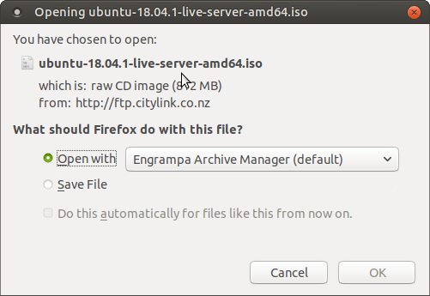
Download
Ubuntu-18.04.1-live-server-amd64.iso

Slide 5
Ubuntu-18.04.1-live-server-amd64 – Fine Print
This release uses our new installer, Subiquity. If you need support for options not implemented in Subiquity, such as encrypted filesystem support, the traditional installer can be found on the alternative downloads page.
Screenshots of Subiquity installer can be found at
http://landoflinux.com/linux_install_ubuntu_server_1804.html

Slide 6
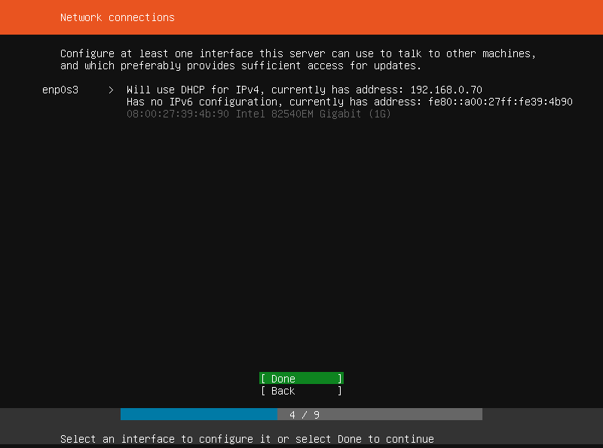
Ubuntu-18.04.1-live-server-amd64
Sample subiquity Installation screen
Note: No wifi device

Slide 7
Ubuntu-18.04.1-live-server-amd64
Uses the new “subiquity” installer.
Only recognises ethernet. Must be connected to continue
Does not support setting up with wifi
9 x Input Screens to perform install
May not be suitable as a base for Desktop Environment.
Try the alternative downloads:
https://www.ubuntu.com/download/alternative-downloads#alternate-ubuntu-server-installer

Slide 8
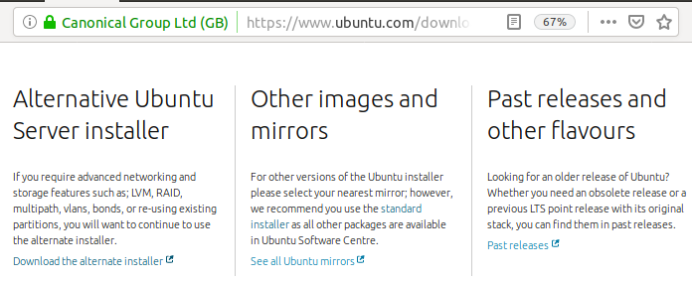
Alternative Ubuntu Server using “d-i” installer.
Check out: https://www.pugetsystems.com/labs/hpc/The-Best-Way-To-Install-Ubuntu-18-04-with-NVIDIA-Drivers-and-any-Desktop-Flavor-1178/

Slide 9
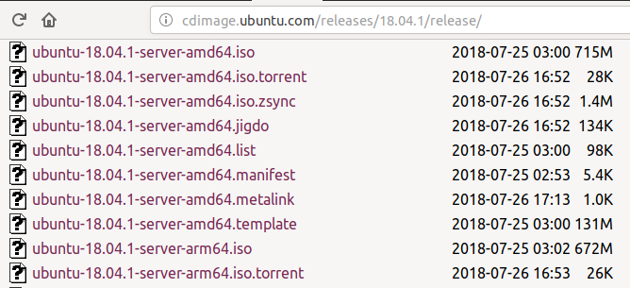
http://cdimage.ubuntu.com/releases/18.04.1/release/
Processor platforms supported:
amd64, arm64, ppc64el, s390 x,
-preinstalled-server-armhf+raspi2.img.xz

Slide 10
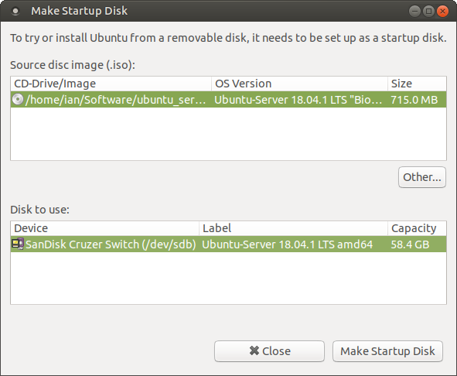
Make a bootable USB stick

Slide 11
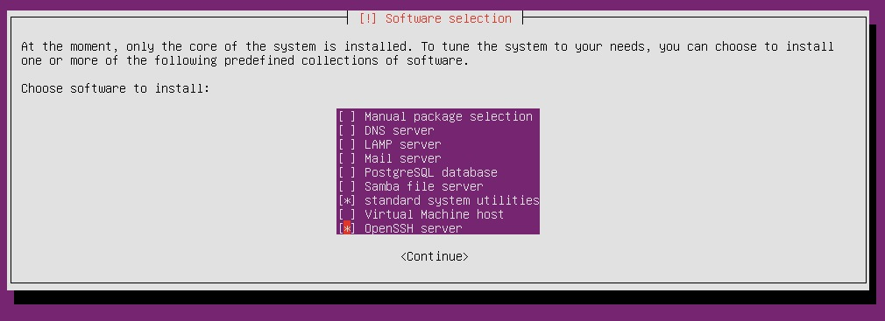
Installation
Boot USB stick
Ability to select ethernet or wifi
~30 x Input screens to perform install (with wifi)
Option to select which server applications to install. (E.g. printer, samba file, DNS.)

Slide 12
Installation
Finish install. Shutdown and boot disk drive.
Boots up to the login prompt. Username / Password
$ sudo apt update
$ sudo apt dist-upgrade (143 packages 72 security)
Six consoles: Ctrl + Alt + F1 to F6.

Slide 13
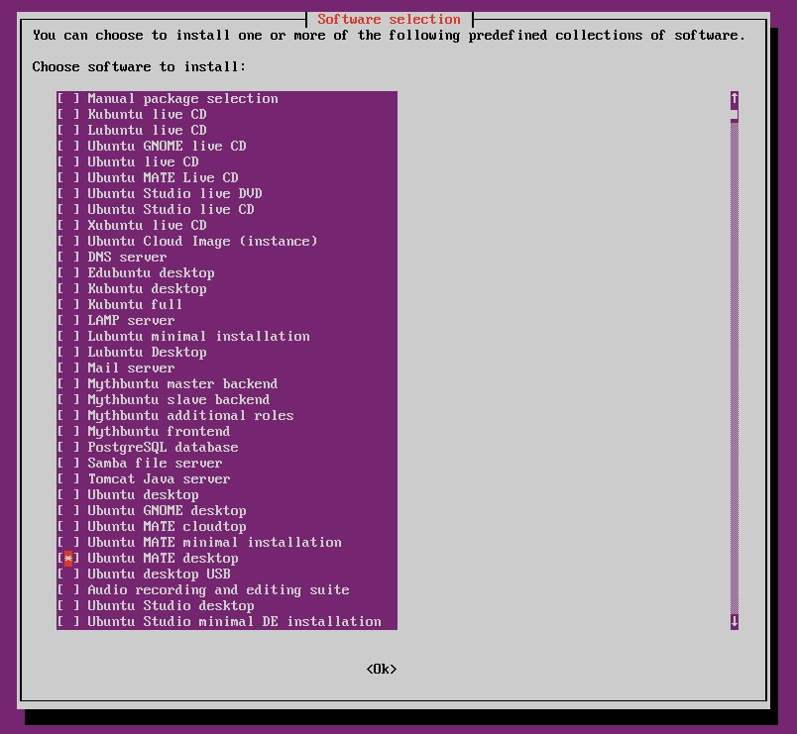
Tasksel application
$ sudo tasksel
Initial default is that only Basic Ubuntu Server is installed.

Slide 14
Tasksel application
Includes options to add:
OpenSSH, DNS, LAMP, Mail, PostgreSQL, Print, Samba File, Tomcat Java servers
Graphical Environment: Kubuntu, Lubuntu, Gnome, Mate,
Graphical Choice of Desktop (includes LibreOffice, etc) or Minimal.

Slide 15
Graphical / Console modes
After installing Graphical app, then boot will take you to the graphical environment.
Can use Ctrl + Alt + F1 to F6 (to drop to consoles)
Use Ctrl + Alt + F7 (to return to graphical environment)
$ runlevel returns N5 (Previously None, now level 5)
$ systemctl get-default (returns graphical.target)
$ systemctl set default multiuser.target (sets runlevel to 3 and on reboot stops at console login prompt.)

Slide 16
Graphical / Console modes
$ startx doesn’t work (sudo apt install init)
$ systemctl isolate graphical.target (Start graphical env)
$ systemctl status graphical.target
$ systemctl isolate multi-user.target (Stop graphical env. Screen goes blank, Ctrl + Alt + F1 opens main console)

Slide 17
Potential Uses
Normally run as a headless server.
Ability to launch graphical environment as required.
Ability to change graphical environments. Mate, KDE, etc.

Slide 18
Bug?
Install a Graphical environment using tasksel.
$ systemctl set-default multi-user.target
Reboot up to console
$ systemctl isolate graphical.target
Attempt to login to Graphical environment fails with:
Unable to contactsettings server
Failed to connect to socket //run/user/1000/bus: Connection refused
Unable to load a failsafe session name. Possible causes:
Xfconfd isn’t running (D-Bus setup problem); environmental variable $XDG_CONFIG_DIRS is set incorrectly (must include “/etc”), or xfce4-session is install incorrectly

Slide 19
Workaround...
Do not use tasksel to install graphical environment.
$ sudo apt install lxde-common –no-install-recommends.
$ sudo apt install lubuntu-core –no-install-recommends
Create xsessions file: $ touch ~/.xsessions
Edit .xsessions: $ nano ~/.xsessions
Add the line: lxsession -s Lubuntu -e LXDE
$ systemctl set-default multi-users.target
$ reboot
See: https://ubuntuforums.org/showthread.php?t=2222849

Slide 20
Perform Demonstration on Server of...
Tasksel
Runlevel
Systemctl get default
Systemctl status graphical.target
Systemctl status multi-user.target
Systemctl isolate graphical.target
Systemctl isolate multi-user.target

Slide 21
Additional Considerations
Auto-mounting of USB sticks as a server
pumount for clean dismounting of USB disks
Changing Wifi Networks

Slide 22
Information on automounting USB drives
A full graphical environment distro will provide automatic mounting of USB drives.
The ubuntu server does not auto-mount USB drives.
USB drives can be manually mounted. E.g.
$ sudo mkdir /mnt/usbdrive
$ sudo mount /dev/sdb1 /mnt/usbdrive
$ ls //mnt/usbdrive/
To automate USB drive mounting...

Slide 23
usbmount and automountusb for mounting USB drives in a console only mode system
$ sudo apt install usbmount
Plug in usb stick(s) /media/usb0/ ... /media/usb7/
Bug needs udevd override: MountFlags=shared
https://github.com/raamsri/automount-usb
Download files and run CONFIGURE.sh
Plug in usb stick /media/sdb1/ or if USB stick has label “my64gbstick” then /media/my64gbstick/

Slide 24
pmount / pumount
If in console environment and using usb mount or automount usb, then you should dismount the USB drive before removing it.
Recommendation is to use pumount . E.g. $ pumount /media/sdb1
May need to $ sudo apt install pmount
pumount (“policy umount”) is a wrapper around the standard umount program which permits normal users to umount removable devices without a matching /etc/fstab entry. https://linux.die.net/man/1/pumount

Slide 25
Hardwired wifi
wifi setup information in /etc/netplan/01-netcfg.yaml
# This file describes the network interfaces
# available on your system
network:
version: 2
renderer: networkd
wifis:
wlp7s4:
dhcp4: yes
access-points:
MyWifi:
password: pass1234

Slide 26
Wifi – Changed Network
On booting fails to find wifi and times out after 90 seconds
Edit//etc/netplan/01-netcfg.yaml
Change Wifi Name and Password
Reboot – Should now find new wifi network
access-points:
OtherWifi: # was: MyWifi
password: pass9876 # was: pass1234

Slide 27
Questions?...

